Slide 1


Intro to Web Scraping
Sign in!

Slide 2
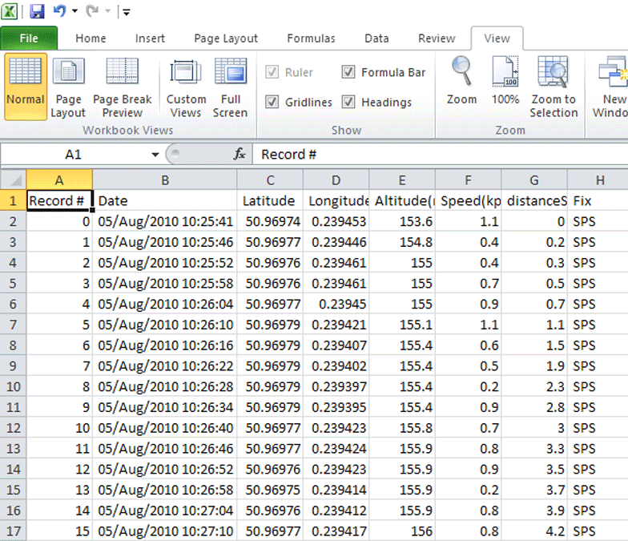



Slide 3
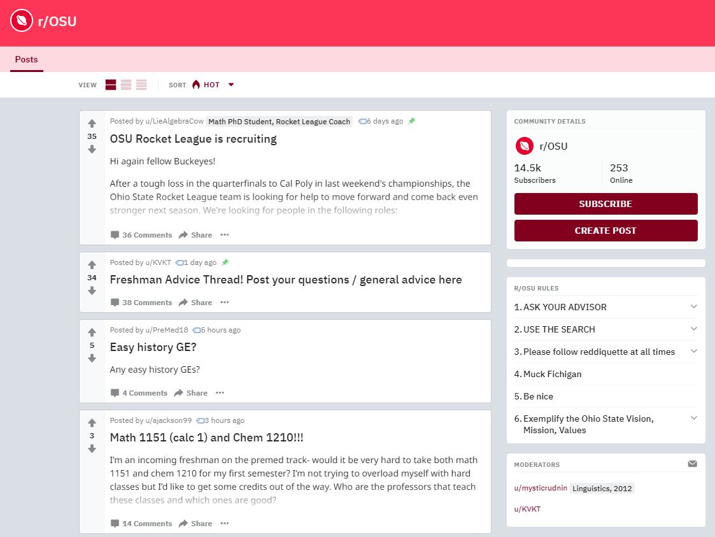

Slide 4

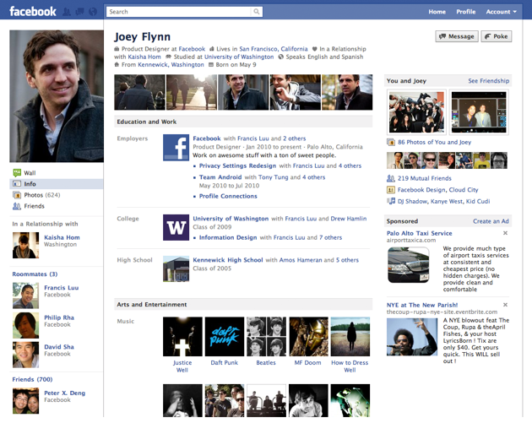

Slide 5







Slide 6

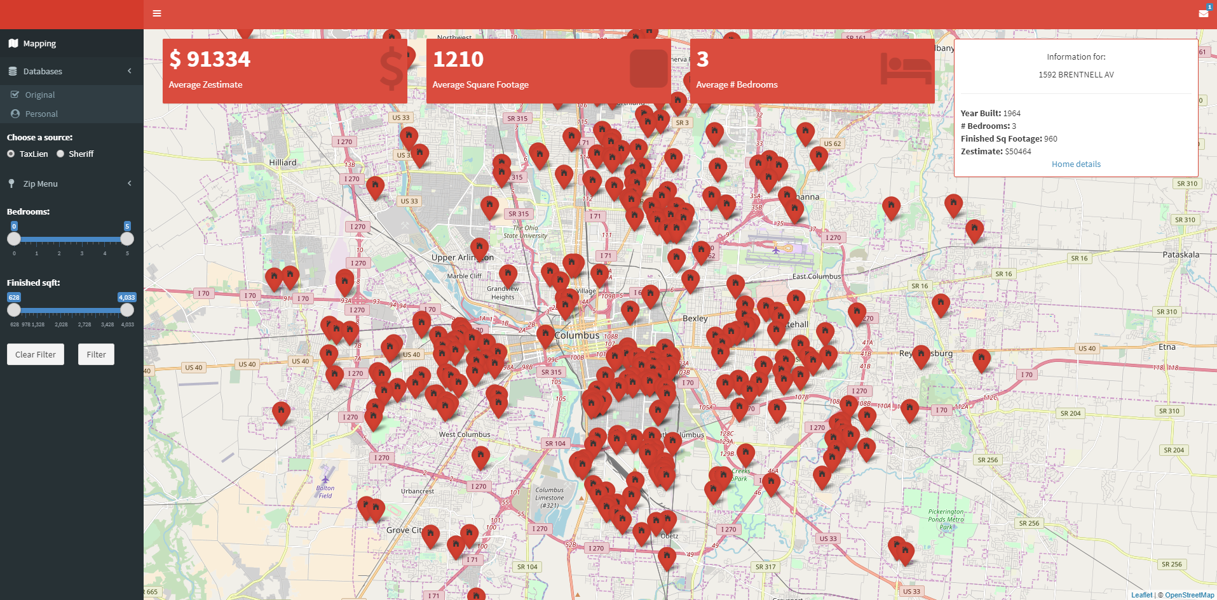

Slide 7
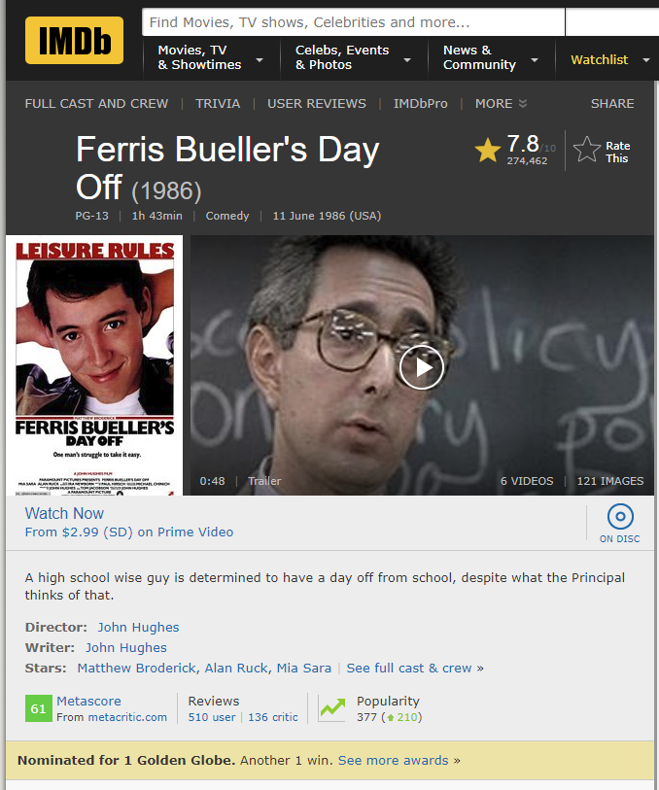
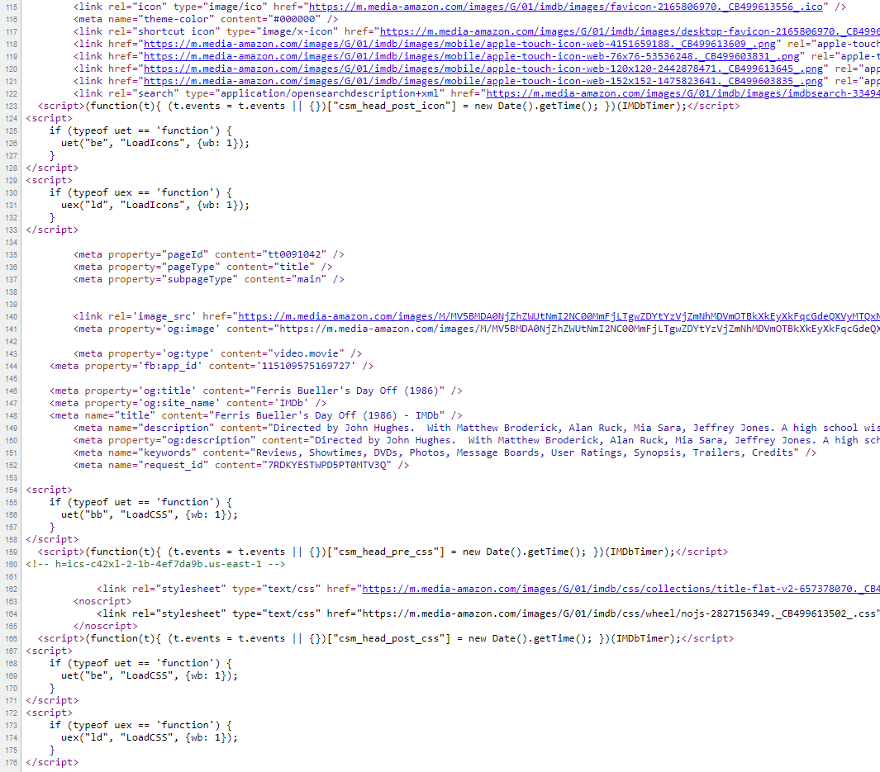

Slide 8


Slide 9



SelectorGadget
BeautifulSoup

Slide 10

Practice - Topic I

Slide 11

Practice - Topic I

Slide 12
Exercises - Topic I

Slide 13

Exercises - Topic I

Slide 14

Exercises - Topic II

Slide 15
